Slide 1






Citizen Entrepreneurship Competition
Présentation d’un programme international
Podim the premier CEE startup & tech event
Is tailored for:
startups & scaleups,
visionary investors,
forward-thinking business executives,
all those with an appetite for ground-breaking ideas and networking..
By Prof. Amal HASSAINE – KAZI TANI & Prof. Mahieddine BOUMENDJEL
Pays d’origine
Public cible
Site web
https://entrepreneurship.de/en/competition

Slide 2

Citizen Entrepreneurship Competition
Présentation d’un programme international
Podim founded in 1980 and situated in
Slovenia,
leading and most influential startup and tech
event in Central and Eastern Europe (CEE),
where innovation converges with business opportunities,
capital infusion,
knowledge exchange, and expertise.
connects you to a global network of
stakeholders eager to collaborate.
By Prof. Amal HASSAINE – KAZI TANI & Prof. Mahieddine BOUMENDJEL
Pays d’origine
Public cible
Site web
https://entrepreneurship.de/en/competition

Slide 3

Citizen Entrepreneurship Competition
Présentation d’un programme international
Why choose to be a Podim startup?
1. Podim connects you with global investors, corporate giants, and collaboration opportunities.
By Prof. Amal HASSAINE – KAZI TANI & Prof. Mahieddine BOUMENDJEL
Pays d’origine
Public cible
Site web
https://entrepreneurship.de/en/competition

Slide 4

Citizen Entrepreneurship Competition
2. Podim offers digital promotion via;
our own and partner channels,
while media outlets and journalists at Podim are eager to amplify your startup’s global reach.
Our lineup of experienced speakers and participants on the main stage and in workshops deliver unfiltered, actionable insights from their own journeys.
Présentation d’un programme international
By Prof. Amal HASSAINE – KAZI TANI & Prof. Mahieddine BOUMENDJEL
Pays d’origine
Public cible
Site web
https://entrepreneurship.de/en/competition

Slide 5
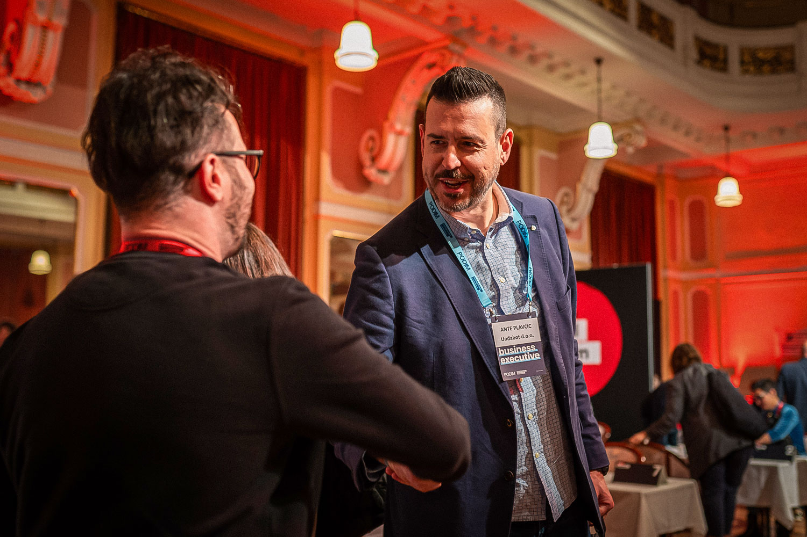
Citizen Entrepreneurship Competition
Présentation d’un programme international
By Prof. Amal HASSAINE – KAZI TANI & Prof. Mahieddine BOUMENDJEL
Pays d’origine
Public cible
3. Secure funding and forge new business partnerships.
Explore the Podim Deal Room, offering an exclusive opportunity to pre-schedule unlimited one-on-one meetings with investors, C-level executives, and accomplished entrepreneurs. With over 1,300 business meetings last year.
Site web
https://entrepreneurship.de/en/competition

Slide 6

Citizen Entrepreneurship Competition
Présentation d’un programme international
By Prof. Amal HASSAINE – KAZI TANI & Prof. Mahieddine BOUMENDJEL
Pays d’origine
Public cible
4. Unlock networking success at Podim
Leverage the Podim App for seamless networking – connect with investors, arrange mentor sessions, and identify potential leads.
Site web
https://entrepreneurship.de/en/competition

Slide 7

Citizen Entrepreneurship Competition
Présentation d’un programme international
By Prof. Amal HASSAINE – KAZI TANI & Prof. Mahieddine BOUMENDJEL
Pays d’origine
Public cible
Unlock networking success at Podim
Leverage the Podim App for seamless networking – connect with investors, arrange mentor sessions, and identify potential leads.
5.Valuable mentoring opportunities
Schedule meetings with founders who’ve overcome all the odds and innovative industry leaders.
Site web
https://entrepreneurship.de/en/competition

Slide 8

Citizen Entrepreneurship Competition
6. Elevate your startup with the Podim Pitching Competition
Présentation d’un programme international
By Prof. Amal HASSAINE – KAZI TANI & Prof. Mahieddine BOUMENDJEL
Pays d’origine
Public cible
Site web
https://entrepreneurship.de/en/competition

Slide 9

Citizen Entrepreneurship Competition
Présentation d’un programme international
By Prof. Amal HASSAINE – KAZI TANI & Prof. Mahieddine BOUMENDJEL
Pays d’origine
Public cible
7. Step into the Podim Marketplace spotlight
Showcase your startup at the heart of Podim. Impress investors, executives, partners, talent, and media by demonstrating your product. Utilize the demo booth to share your product’s story and development background.
Site web
https://entrepreneurship.de/en/competition

Slide 10
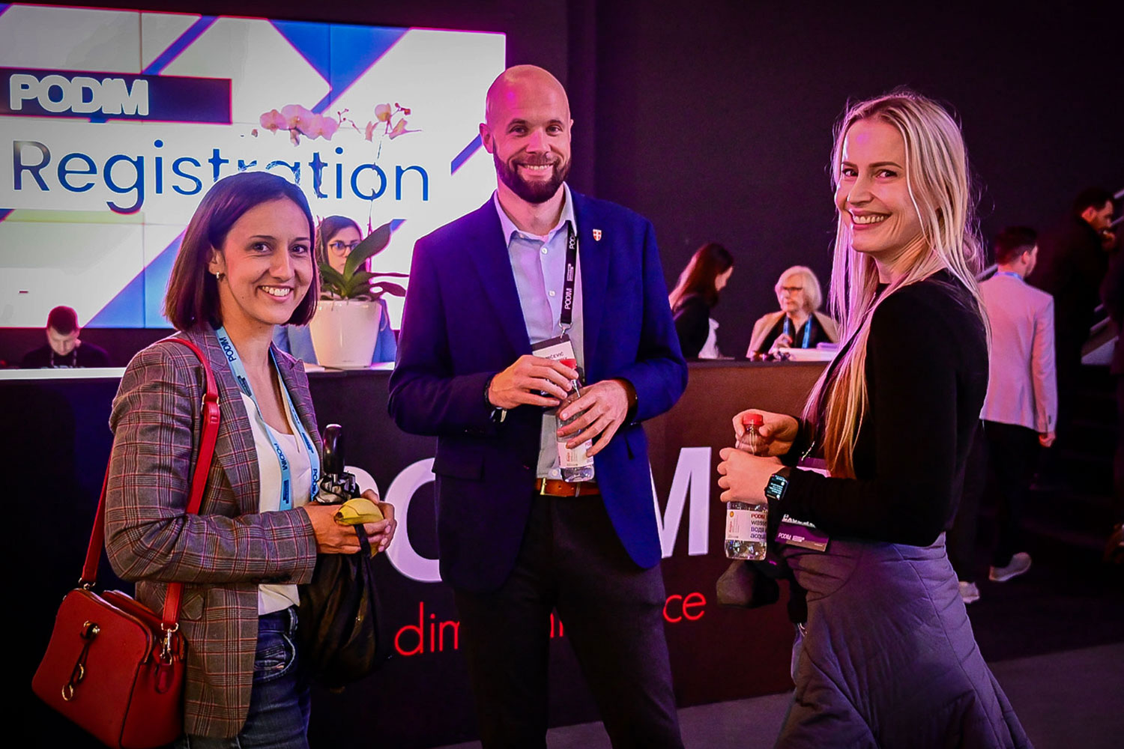
Citizen Entrepreneurship Competition
Présentation d’un programme international
By Prof. Amal HASSAINE – KAZI TANI & Prof. Mahieddine BOUMENDJEL
Pays d’origine
Public cible
8. Searching for talent?
Podim is your go-to destination if you’re seeking fresh team members. With a gathering of up to 1,000 tech-savvy change-makers.
Site web
https://entrepreneurship.de/en/competition

Slide 11
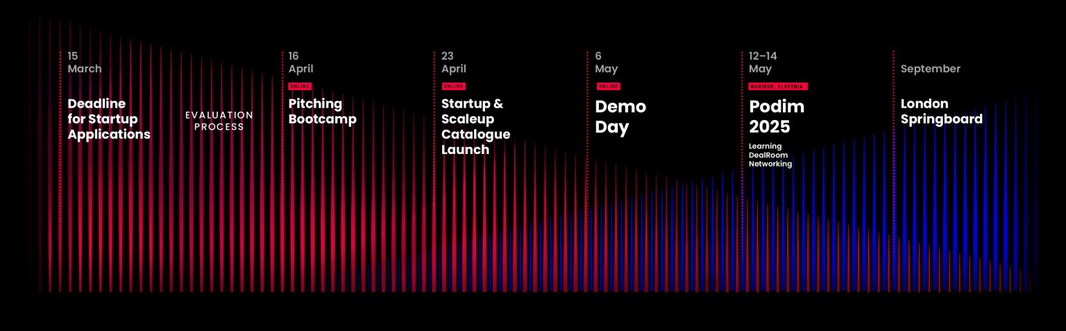
Citizen Entrepreneurship Competition
Présentation d’un programme international
Podim's year-round impact
Beyond the Podim summit, our events like Bootcamp, Demo Days , and networking events connect the ecosystem, offer extra touchpoints for Podim partners and highlight opportunities.
By Prof. Amal HASSAINE – KAZI TANI & Prof. Mahieddine BOUMENDJEL
Pays d’origine
Public cible
Site web
https://entrepreneurship.de/en/competition

Slide 12

Commission Nationale de Suivi des Programmes Internationaux de Soutien l'Innovation et de l'Entreprenariat
اللجنة الوطنية لمتابعة البرامج الدولية لدعم الإبتكار والمقاولاتية
Présentation d’un programme international
What's the next move?

Slide 13
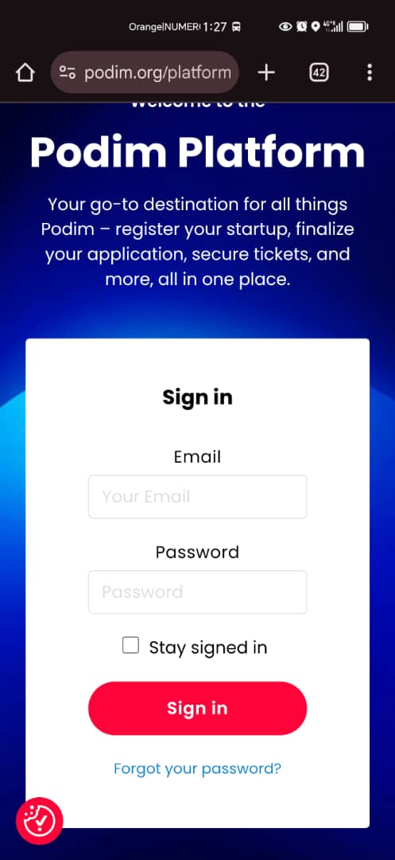
Citizen Entrepreneurship Competition
Présentation d’un programme international
By Prof. Amal HASSAINE – KAZI TANI & Prof. Mahieddine BOUMENDJEL
Pays d’origine
Public cible
Site web
https://entrepreneurship.de/en/competition

Slide 14
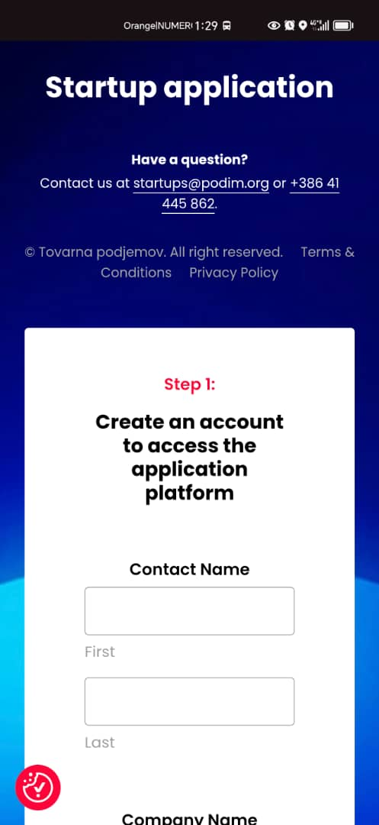
Citizen Entrepreneurship Competition
Présentation d’un programme international
By Prof. Amal HASSAINE – KAZI TANI & Prof. Mahieddine BOUMENDJEL
Pays d’origine
Public cible
Site web
https://entrepreneurship.de/en/competition

Slide 15
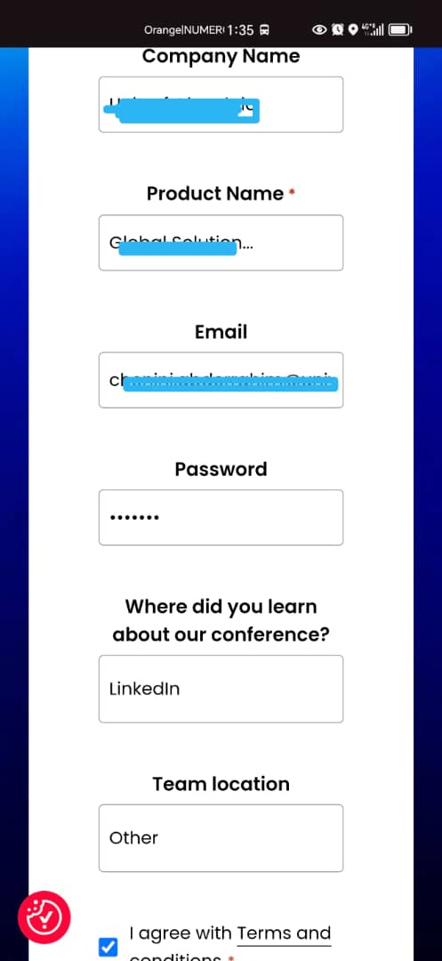
Citizen Entrepreneurship Competition
Présentation d’un programme international
By Prof. Amal HASSAINE – KAZI TANI & Prof. Mahieddine BOUMENDJEL
Pays d’origine
Public cible
Site web
https://entrepreneurship.de/en/competition

Slide 16
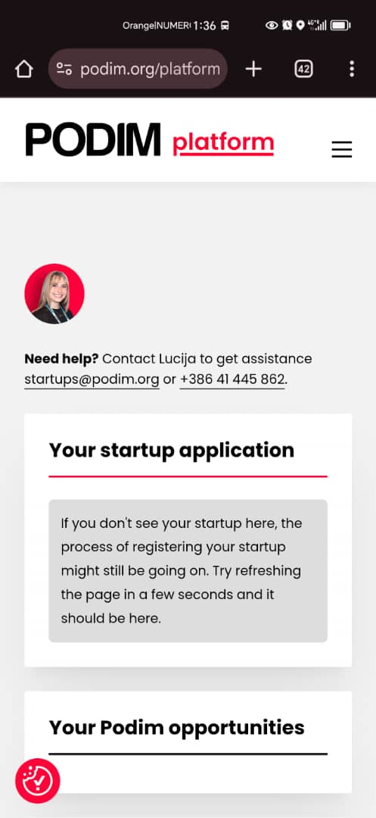
Citizen Entrepreneurship Competition
Présentation d’un programme international
By Prof. Amal HASSAINE – KAZI TANI & Prof. Mahieddine BOUMENDJEL
Pays d’origine
Public cible
Site web
https://entrepreneurship.de/en/competition

Slide 17
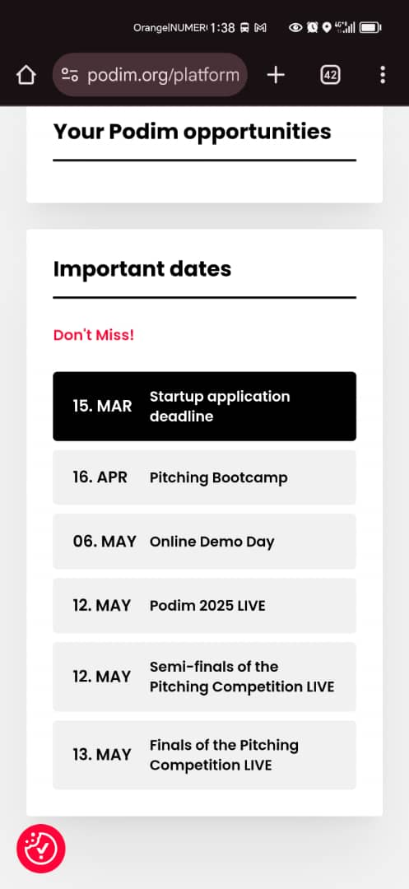
Citizen Entrepreneurship Competition
Présentation d’un programme international
By Prof. Amal HASSAINE – KAZI TANI & Prof. Mahieddine BOUMENDJEL
Pays d’origine
Public cible
Site web
https://entrepreneurship.de/en/competition

Slide 18
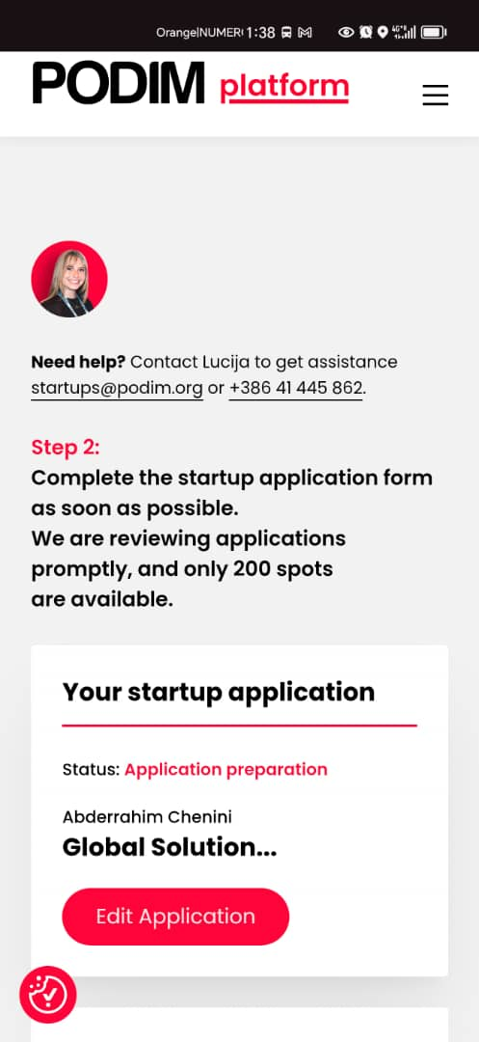
Citizen Entrepreneurship Competition
Présentation d’un programme international
By Prof. Amal HASSAINE – KAZI TANI & Prof. Mahieddine BOUMENDJEL
Pays d’origine
Public cible
Site web
https://entrepreneurship.de/en/competition

Slide 19
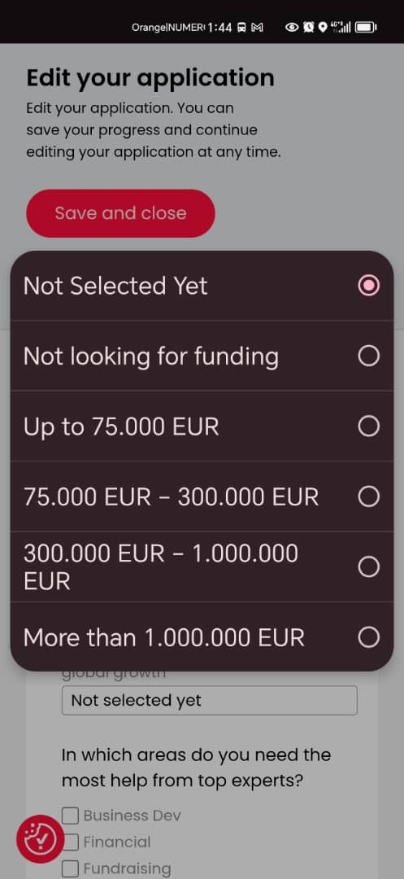
Citizen Entrepreneurship Competition
Présentation d’un programme international
By Prof. Amal HASSAINE – KAZI TANI & Prof. Mahieddine BOUMENDJEL
Pays d’origine
Public cible
Site web
https://entrepreneurship.de/en/competition

Slide 20
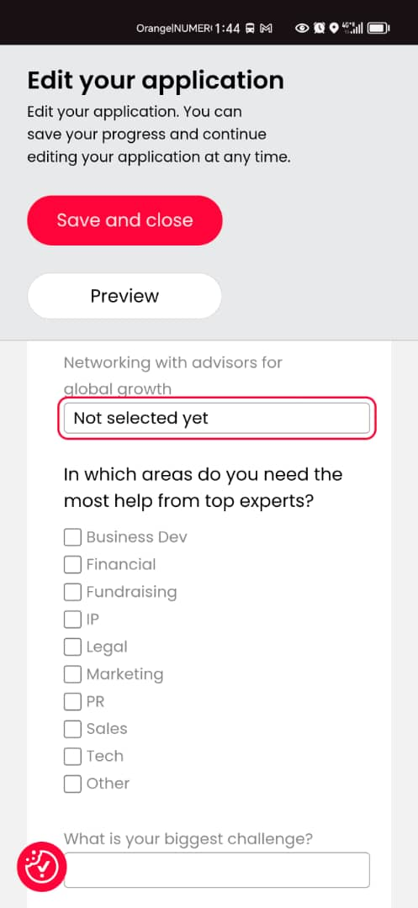
Citizen Entrepreneurship Competition
Présentation d’un programme international
By Prof. Amal HASSAINE – KAZI TANI & Prof. Mahieddine BOUMENDJEL
Pays d’origine
Public cible
Site web
https://entrepreneurship.de/en/competition

Slide 21
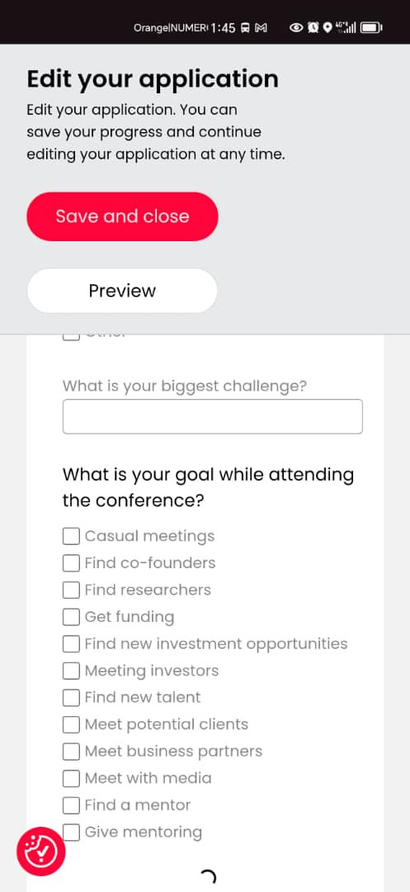
Citizen Entrepreneurship Competition
Présentation d’un programme international
By Prof. Amal HASSAINE – KAZI TANI & Prof. Mahieddine BOUMENDJEL
Pays d’origine
Public cible
Site web
https://entrepreneurship.de/en/competition

Slide 22
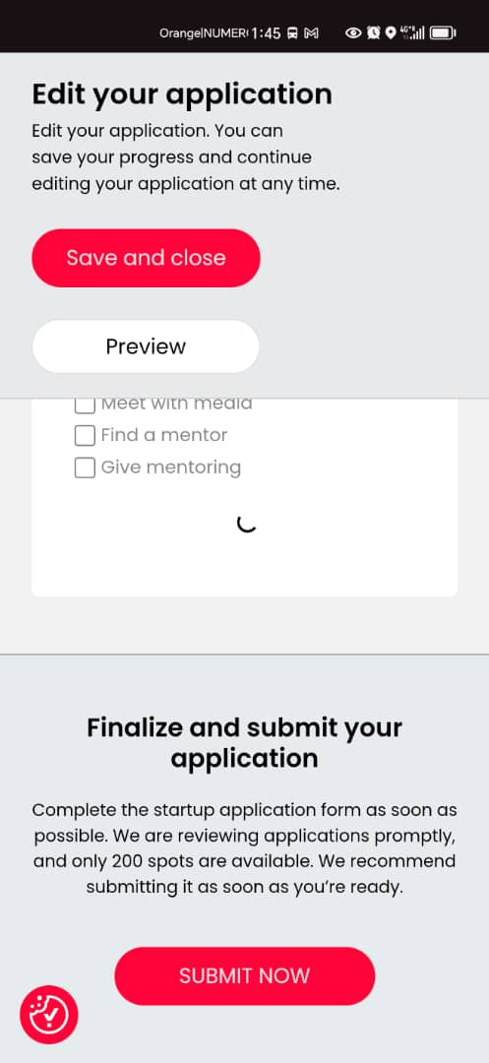
Citizen Entrepreneurship Competition
Présentation d’un programme international
By Prof. Amal HASSAINE – KAZI TANI & Prof. Mahieddine BOUMENDJEL
Pays d’origine
Public cible
Site web
https://entrepreneurship.de/en/competition

Slide 23



Commission Nationale de Suivi des Programmes Internationaux de Soutien l'Innovation et de l'Entreprenariat
اللجنة الوطنية لمتابعة البرامج الدولية لدعم الإبتكار والمقاولاتية
Présentation d’un programme international

Slide 24

Citizen Entrepreneurship Competition
Présentation d’un programme international
By Prof. Amal HASSAINE – KAZI TANI & Prof. Mahieddine BOUMENDJEL
Pays d’origine
Public cible
https://podim.org/
Site web
https://entrepreneurship.de/en/competition

